Slide 1

MGM Institute of Physiotherapy
Aurangabad
MAHATMA GANDHI MISSION
Didactic Lecture

Slide 2
Elbow joint assessment
Dr. surendra Wani
Dept. Of Musculoskeletal Physiotherapy
MGM Institute Of Physiotherapy
Chh. Sambhajinagar

Slide 3
Objectives
To understand and learn to assess the elbow joint subjectively and objectively.

Slide 4
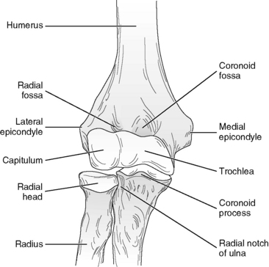
Introduction
- synovial joint between the lower end of humerus and upper ends of radius and ulna bones.
- elbow joints contain humeroradial and humeroulnar joints.

Slide 5
Carrying Angle..
Transverse axis of the elbow joint is directed medially and downwards. Because of this, the extended forearm is not in straight line with the arm , but makes an angle of about 13 degree with it. This is known as carrying angle.
Disappears in full flexion & pronation.
Male - 10 to 15 degree
Female - more than 15 degree

Slide 6
Demographic Data
Name -
Age -
Sex -
Occupation -
Religion -
Dominance -
Date of admission -
Date of evaluation -

Slide 7
Chief complaints
Why the patient come for help ?
What are the complaints patients come with ?
Tennis elbow
Golfers elbow
Students elbow(miner's )
Cubitus valgus
Cubitus varus
Gun stock deformity

Slide 8
History of present illness
When did the accident occur or the what was the mechanism of the injury ?
Has the elbow injured before ?
How long has the patient had the problem ?
Does the condition come and go ?
What activities aggravate the problem ?

Slide 9
Pain assessment
What are the details of the present pain and other symptoms ?
What are the boundaries and site of the pain ?
Is pain radiating and is it worse at night ?
Are there any activities that increase or decrease pain ? Does pulling (traction) twisting (torque) or pushing (compression) after the pain ?
Are there any position that relieve the pain ?

Slide 10
Past history
Past surgical history
Past medical history
Does the patient have a history of surgery or past illness ?
What was the site of operations and what condition was being treated ?
Does the patient have history of hypertension , diabetes mallitus

Slide 11

Drug history
Has the patient been received analgesics , steroids or any other medications ? If so for how long ?
When did he last take the medication ?
Did the medication help ?

Slide 12
Personal history
Appetite
Sleep
Bowel
Bladder

Slide 13
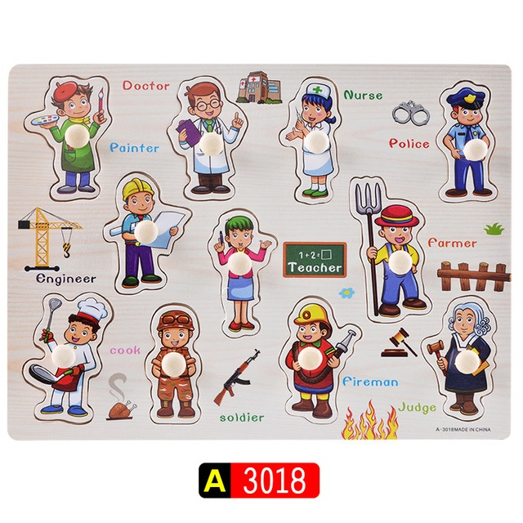
Occupational history
What is the patient occupation ?
What does the patient do at the work ?
Does he use special support ?
How many hours he works ?

Slide 14

Socioeconomic history
What is the socioeconomic status of the patient ?
What is the educational status ?
Kuppuswami scale.

Slide 15
Environmental history
What is the environment of the house ?
House is made up of ?
Flooring present or not ?
Well ventilated or not ?

Slide 16
General physical examination
BMI
Patients body built
Vitals - PR , RR , BP , temp , PICCLE

Slide 17
On observations
General observations
Posture -
Anterior view - The examiner first places the patients arm in the anatomical position to determine whether there is a normal carrying angle.
Cubitus valgus
Cubitus varus
Gun stock deformity
Anterior and posterior view - look for normal bony and soft tissue contours

Slide 18
Examiner should note whether the patient can assume the normal position of function of the elbow . (90 degree flexion)
Gait -
Is the gait is normal ?
Patients attitude -
Which type of attitude patients have ?

Slide 19
Local physical examination
On inspection
Patients position -
Attitude of limb -
Deformity - Is there any deformity of joint ?
Tennis elbow
Golfers elbow
Students elbow
Gun stock deformity
Cubitus valgus
Cubitus varus

Slide 20
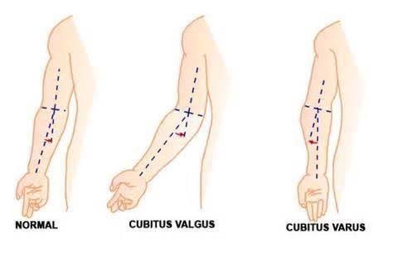
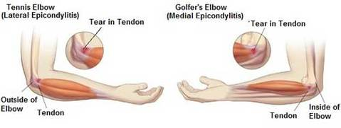

Slide 21
Bony contours - is there any bony contours present over the joint ?
Soft tissue contours
Muscle wasting
Swelling
Oedema
Scar
Wounds / ulcer
Bandage

Slide 22
On palpation
Local temperature
Tenderness - check on the bony prominent
Muscle spasm
Muscle wasting
Swelling
Odema
Crepitus

Slide 23
Scar examination
Is there any scar present over the joint ?
Whict type of scar it is ? Healed or unhealed ?
Length of scar ?
Adherent or non adherent ?
Is is discharging or non discharging scar ?

Slide 24
Sensory examination
Superficial sensation
Pain
Touch
Temperature
Deep sensations
Proprioception , kinesthesia , vibration
Cortical sensation

Slide 25
Joint examination
1. Active movements - painfree complete / painful complete , painfree limited / painful limited
2. Passive movements - painfree complete / painful complete , painfree limited / painful limited

Slide 26
Capsular pattern
Combined movements - Regular strech pattern , regular compression pattern , irregular pattern
Accessory movement /joint play.

Slide 27
Muscle examination
1. Muscle strength
2. Muscle length
3. Resisted isometrics
4. Muscle girth

Slide 28
Nerve examination
1. Integrity of the nervous system.
Myotomes
Dermatoms
Reflex testing

Slide 29
Measurements
Limb length
True
Apparent
Segmental

Slide 30
SUMMARY & QUestions
Carrying angle. 3 marks
Three point relationship. 3 marks

Slide 31


